Slide 1


Slide 2
The best DevOps company *
* according to us

Slide 3
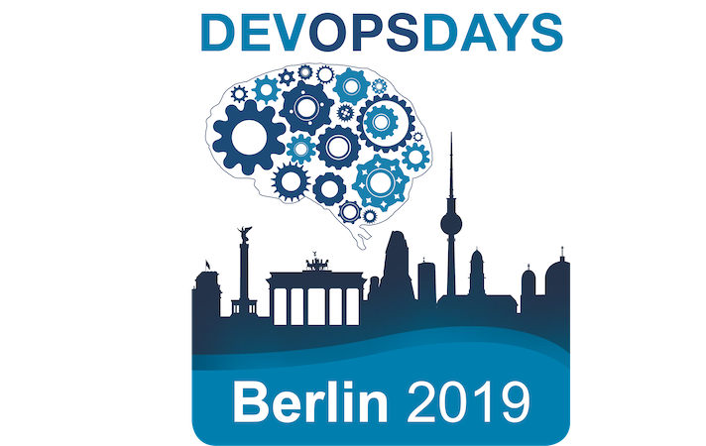
When will DevOps Die?
“Ideas are to objects as constellations are to stars”
― Walter Benjamin

Slide 4
Who am I ?
Yair Etziony, DevOps Lead Germany at Polar Squad Berlin.
Over 20 years experience as Sysadmin, QA engineer, and DevOps.
Studied Philosophy and German history, a musician.
Twitter: @EtzionyYair

Slide 5

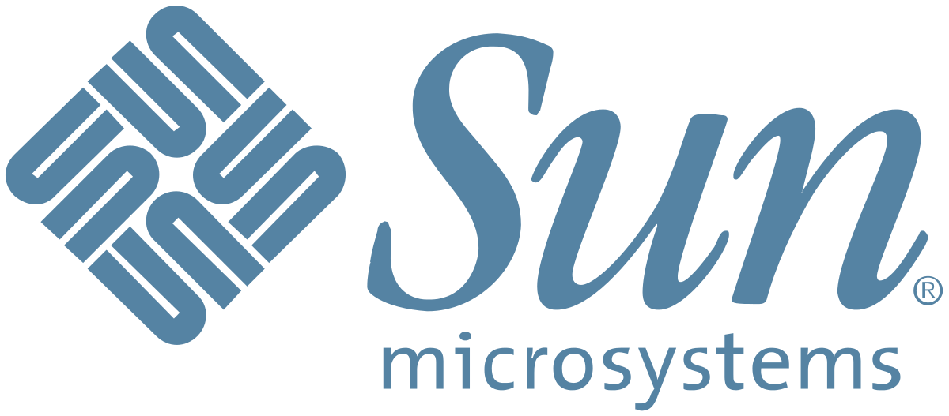
Some thoughts about the future
In 1999 Our old SysAdmin told me: “Solaris is a dead end, NT4 is killing us, I don't see any future for Unix”

Slide 6
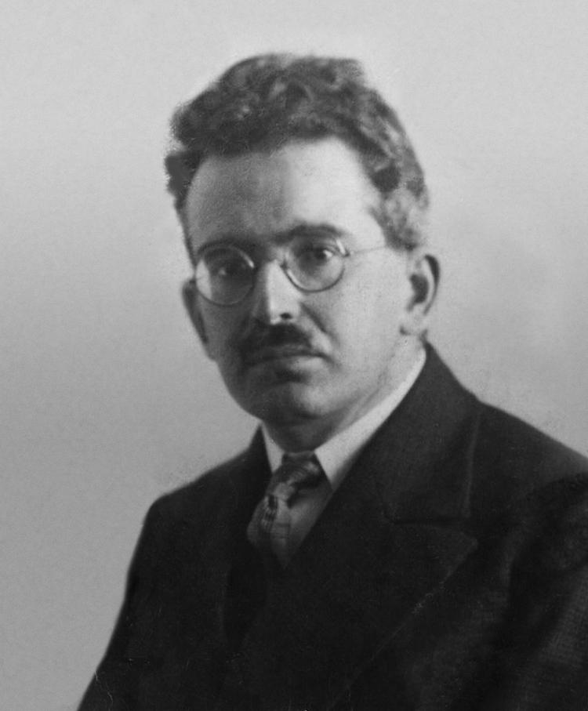
Constellations and stars,
Ideas and Objects?
Walter Benjamin is a philosopher, literary critic and many other things.
The idea comes from his book “The Origin of German Tragic Drama”
Meaning that when you look at a group of stars, you see patterns that are constellations. Same will be applied to objects and ideas!

Slide 7

So what constellations do I see?

Slide 8
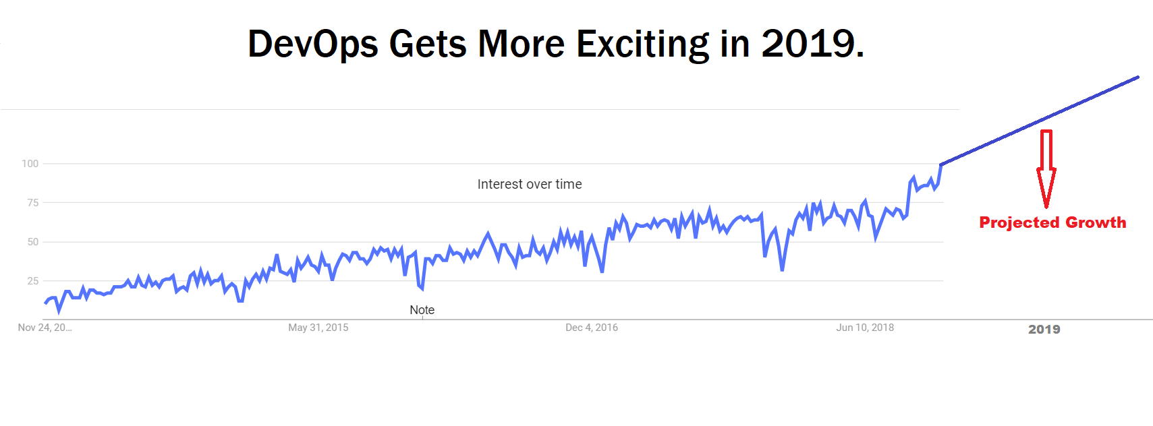
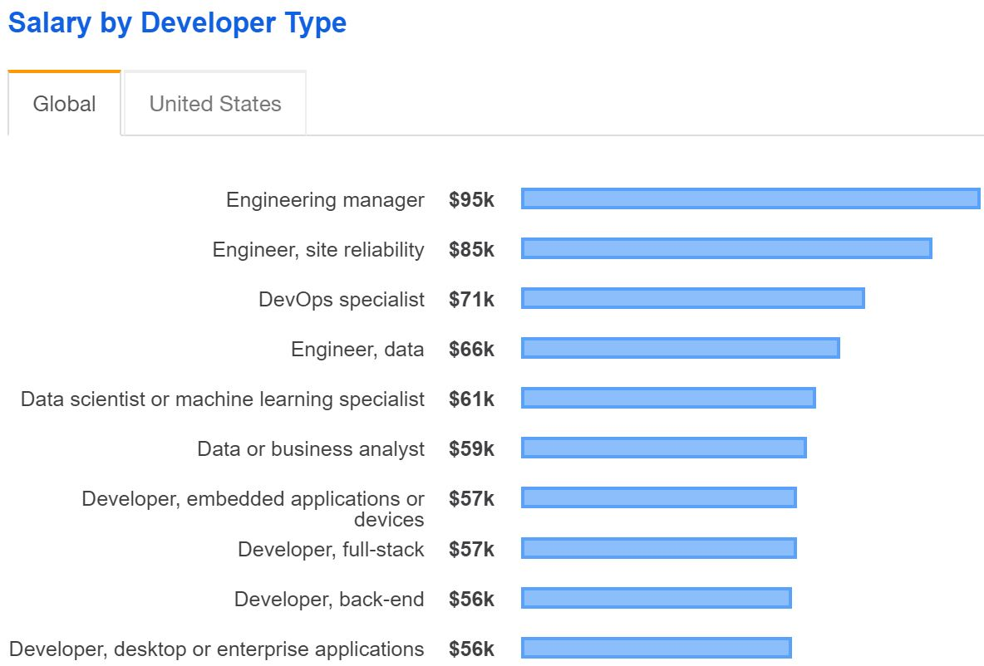
Demand for DevOps is on the rise!

Slide 9




They used to be trendy but now?

Slide 10
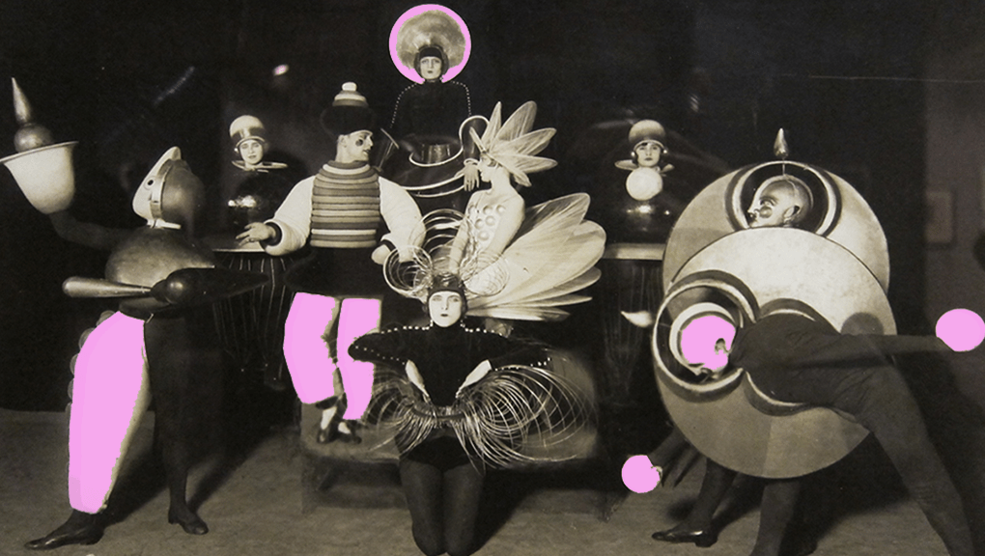
From avant garde to mainstream
Can this marriage really happen?

Slide 11
What is DevOps ?
DevOps is a loose set of practices, guidelines and culture, designed to break down silos in IT development, operations, networking and security.
Sharing and collaboration are at the forefront of this movement.
DevOps is first and foremost a cultural change!

Slide 12

What is a DevOps engineer ?
How can we engineer culture?

Slide 13
What is Not DevOps ?
DevOps is not coupled to any tools, It's not about Kubernetes, Chef or Terraform.
DevOps is first and foremost a cultural change!

Slide 14

We agree that DevOps have some strong cultural side to it, yet the profiles of people we are looking for are normally of a System Engineer
#Fail?

Slide 15
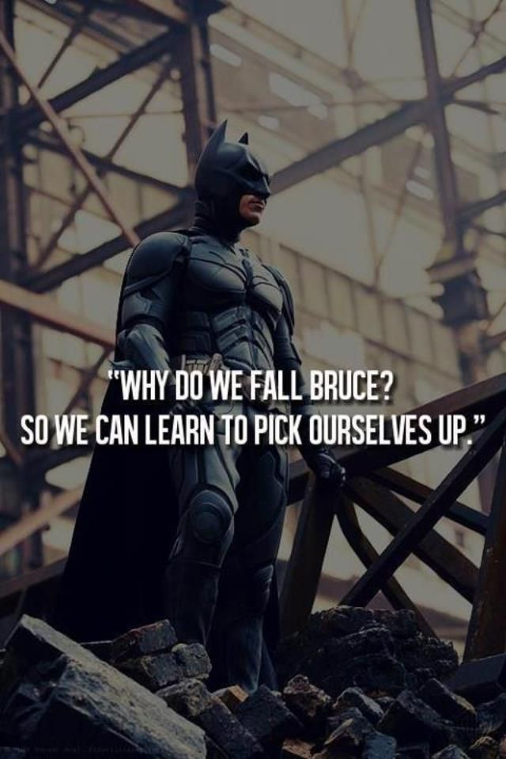
If part of the work is cultural
But we look for technical expert only
We raise the chances of failing !

Slide 16

Do we have the skills for this kind of a job? How can we build teams which are more DevOps? Does it make sense?
#Fail

Slide 17



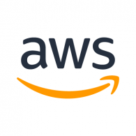


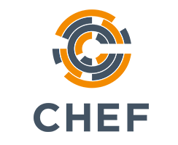

Trends, changes and shifts in DevOps.
Tools we used in 2015 and tools we use now

Slide 18
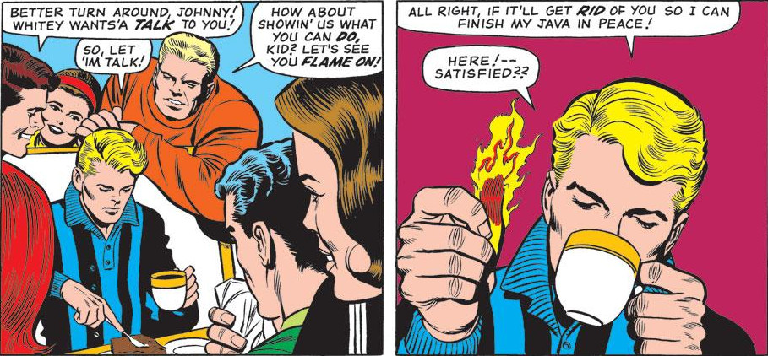
Ask yourself:
“As a DevOps Engineer, do i work in a DevOps environment or am i still part of a classic operations team labeled differently?”
#Fail

Slide 19
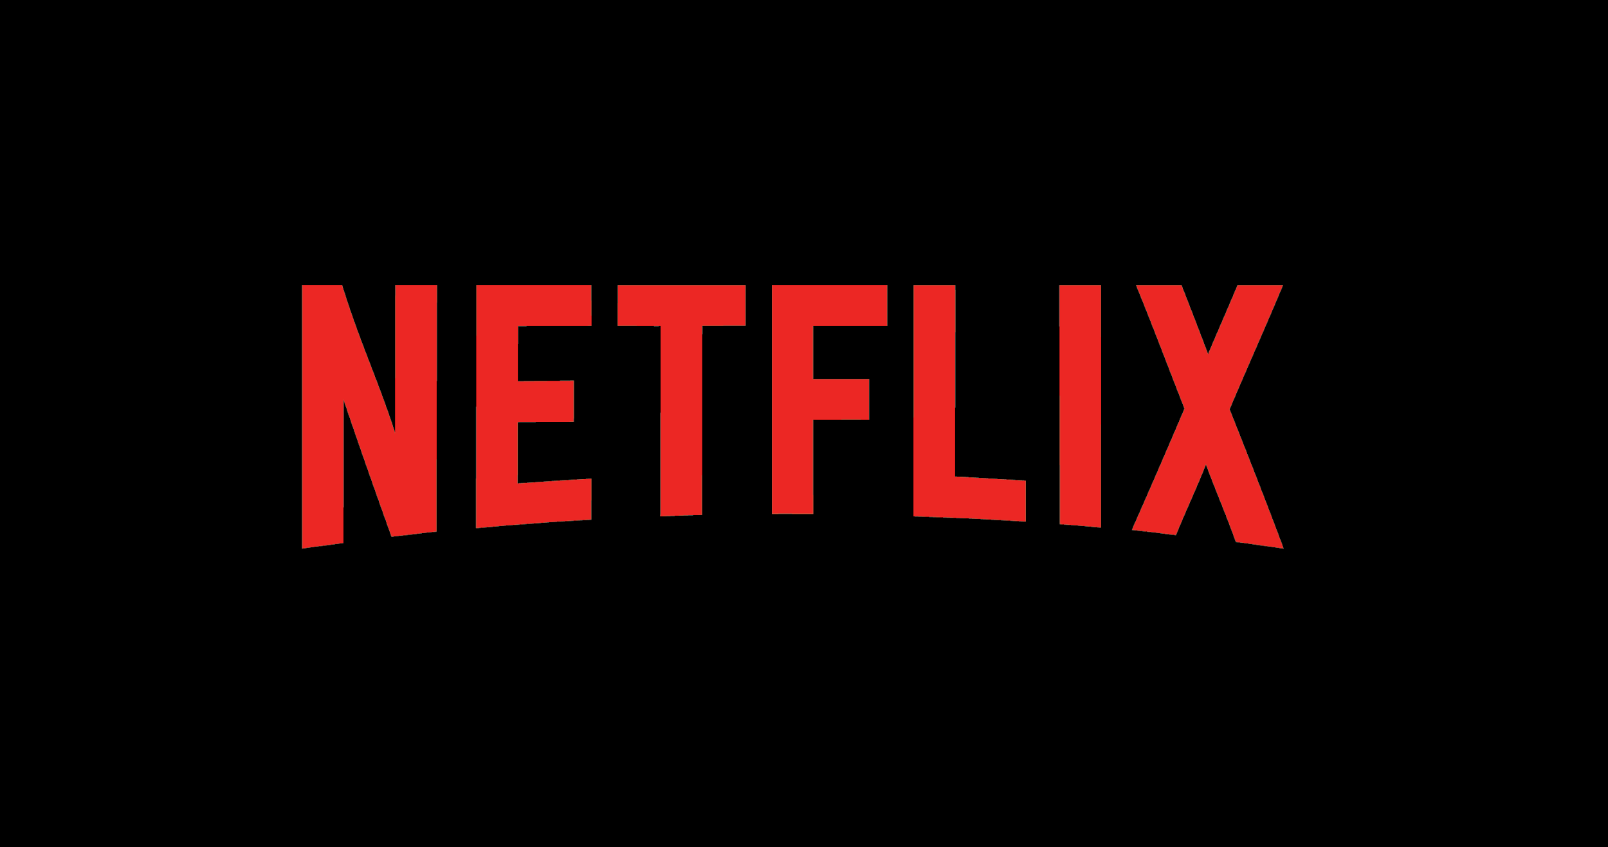
New Job Offering:
Sr. Resilience Engineering Advocate - Netflix
The goal of the education and outreach function of the SRE team is to improve reliability and resilience of Netflix services by focusing on the people within the company, since it's the normal, everyday work of Netflix employees that creates our availability.
Netflix as a socio-technical system is formed from the interaction of people and software. This system has many components and is constantly undergoing change.
https://jobs.netflix.com/jobs/869465

Slide 20
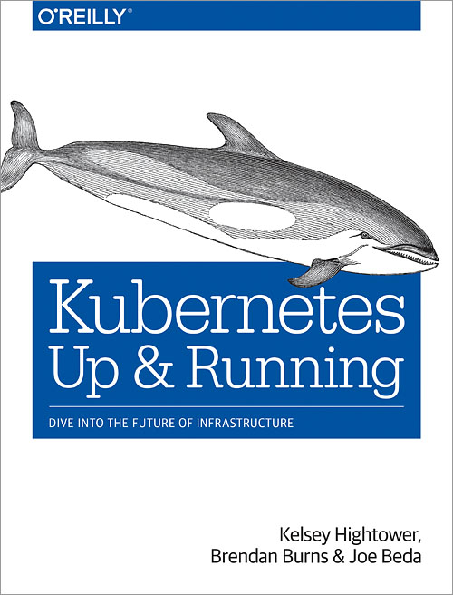
K8s is a new trend
Kubernetes: A Dedication
“Kubernetes would like to thank every
Sysadmin who woken up at 3 A.M. to
Restart a process...”
Kelsey Hightower, Brendan Burns & Joe Beda

Slide 21
DevOps - the good, the bad, the ugly and the contradiction.
Real DevOps working environments are hard to find - I don't think I ever worked in a real DevOps environment.
How can we break silos, when we are in a silo?
When failing or succeeding, DevOps are cannibalizing their own business.
For good and for bad, we will slowly automate ourselves useless.

Slide 22
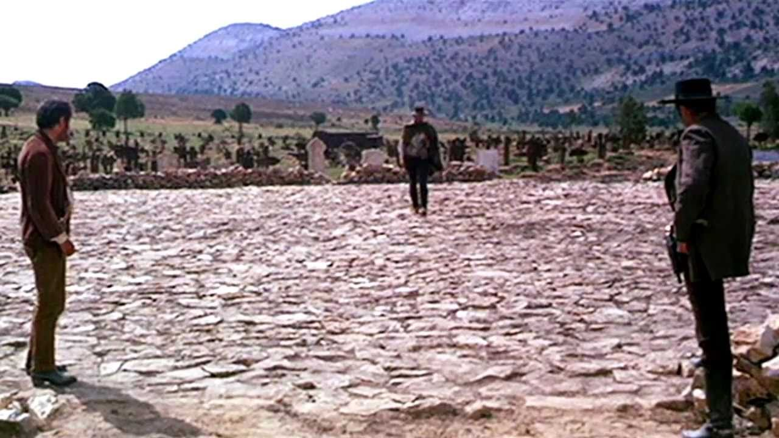
If you wanna shoot, shoot - don't talk!

Slide 23
Some thoughts about the future
DevOps Consultant and not DevOps Engineer
SRE is a valid praxis
Writing codes and wrapper apps around the next generation Developer oriented infra
We will have more options to mentor and guide teams
DevSecOps!
Developer centric environments
Cultural ideas will be the next big thing in R&D teams
DevOps is a good practice, it's just not so well defined

Slide 24

“Every Night and every Morn Some to Misery are Born. Every Morn and every Night Some are Born to sweet delight. Some are Born to sweet delight, Some are Born to Endless Night.”
I see the world, William Blake

Slide 25
Night of the living OPs

